Slide 1

Git. Genau wie Subversion nur anders

Slide 2

Subversion vs Git
Windows Desktop Integration
Checkout
Commit
Add File(s)
Remove File(s)
Revert
Update

Slide 3


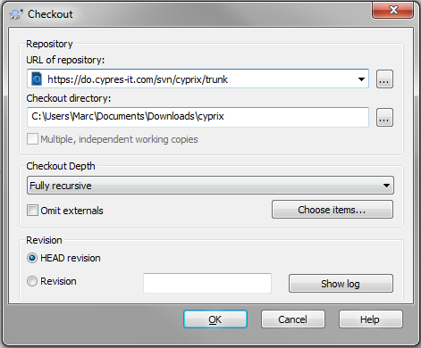
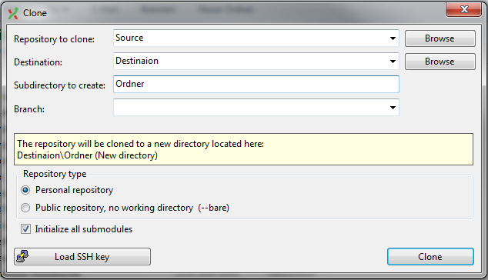
Checkout
Subversion
Git

Slide 4
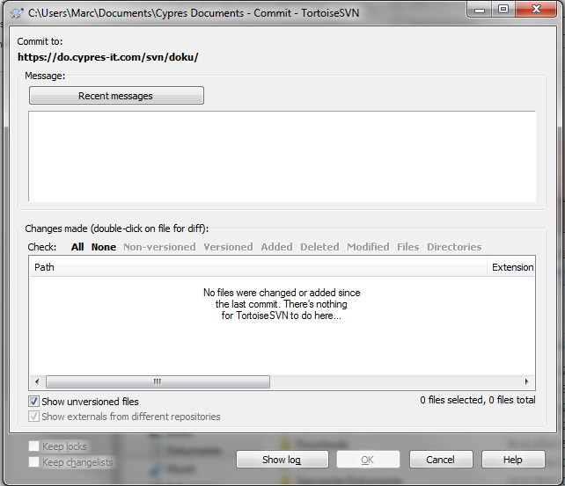
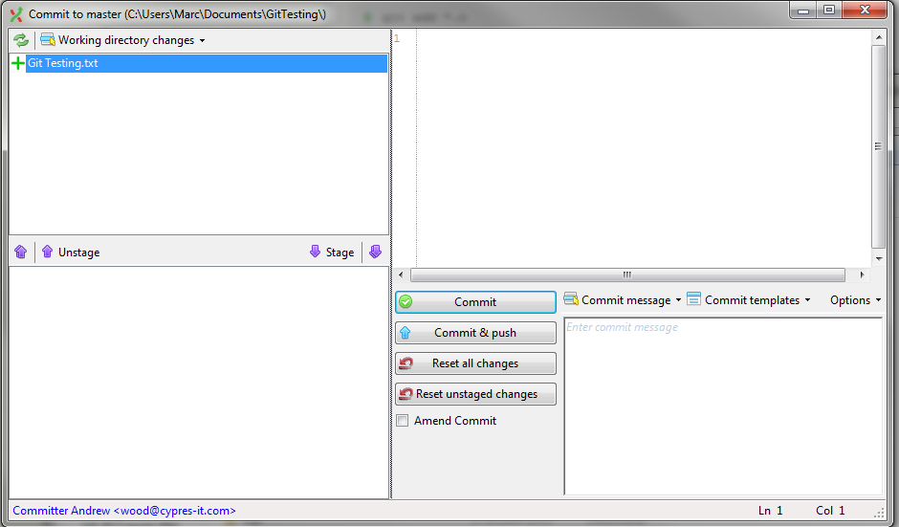
Commit
Subversion
Git

Slide 5
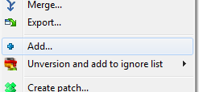
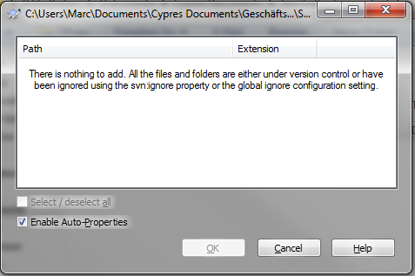
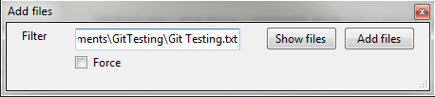
Add File(s)
Subversion
Git

Slide 6
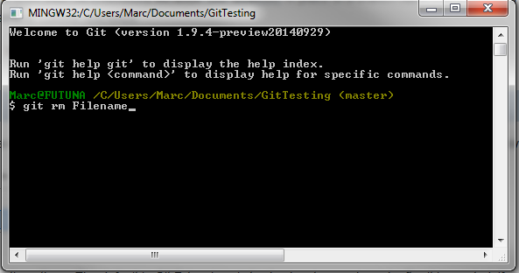
Remove File(s)
Subversion
Git
Can only be done from the command prompt

Slide 7
Revert
Subversion
Git

